Slide 1

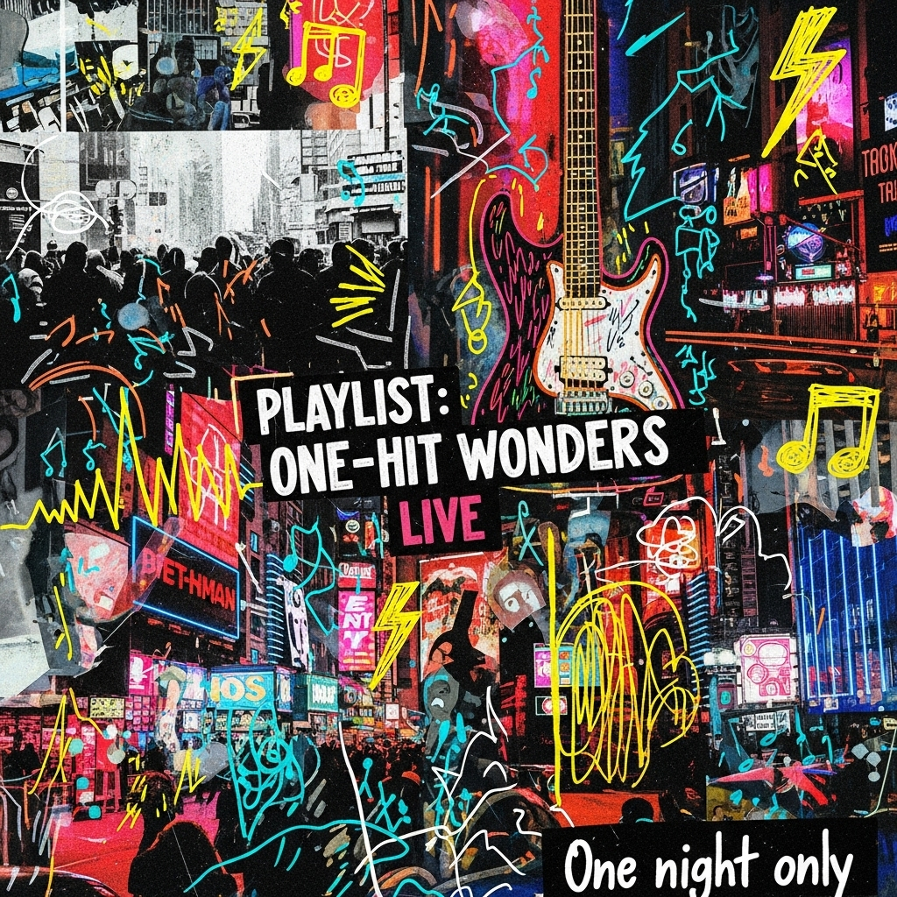
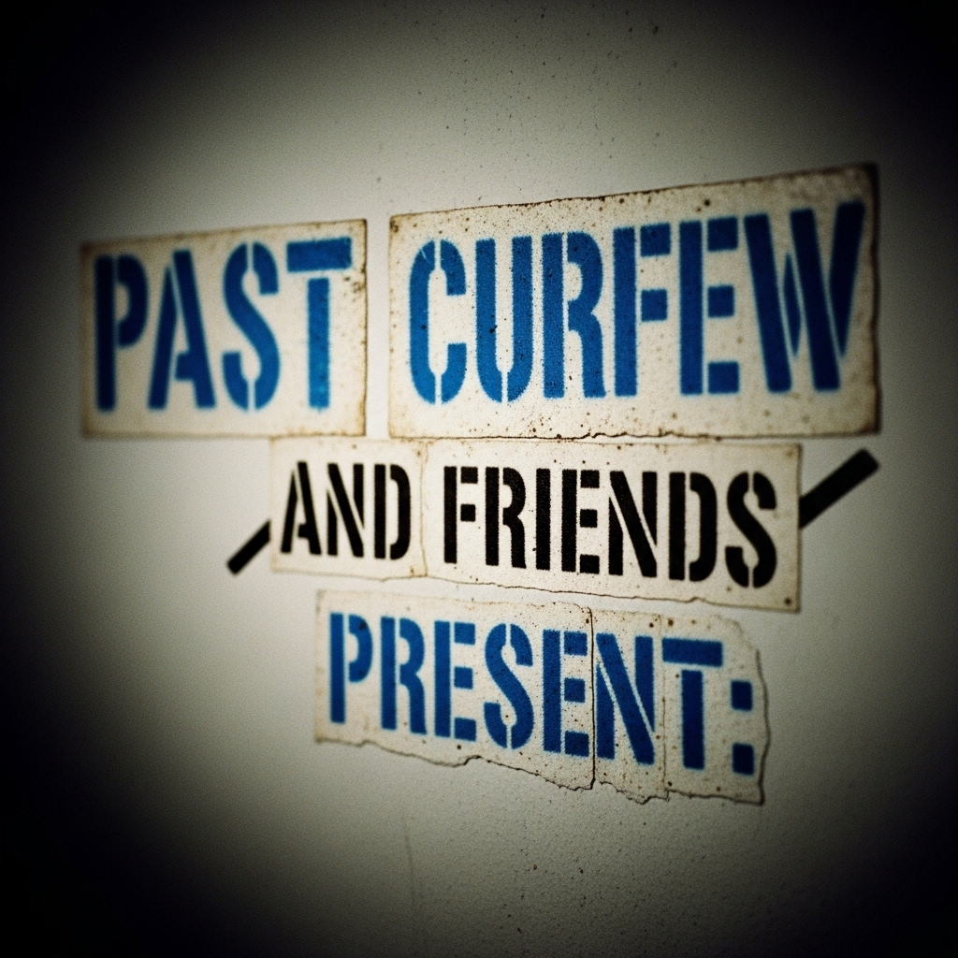

A
benefit
concert for
Guild Theatre
Menlo Park, CA
October 24, 2025

Slide 2

A
benefit
concert for
Guild Theatre
Menlo Park, CA
October 24, 2025

Slide 3

A
benefit
concert for
Guild Theatre
Menlo Park, CA
October 24, 2025

Slide 4

A
benefit
concert for
Guild Theatre
Menlo Park, CA
October 24, 2025

Slide 5

A
benefit
concert for
Guild Theatre
Menlo Park, CA
October 24, 2025

Slide 6

A
benefit
concert for
Guild Theatre
Menlo Park, CA
October 24, 2025

Slide 7

A
benefit
concert for
Guild Theatre
Menlo Park, CA
October 24, 2025

Slide 11
Past Curfew
and Friends
Present:
A
benefit
concert for
October 24, 2025
Tickets at guildtheatre.com
The Guild Theatre | Menlo Park, CA
October 24,
2025

Slide 12

Past
Curfew
and Friends
Present:
A
benefit
concert for
October 24, 2025
Tickets at guildtheatre.com
The Guild Theatre | Menlo Park, CA

Slide 13

Past
Curfew
and Friends
Present:
A
benefit
concert for
October 24, 2025
Tickets at guildtheatre.com
The Guild Theatre | Menlo Park, CA

Slide 14
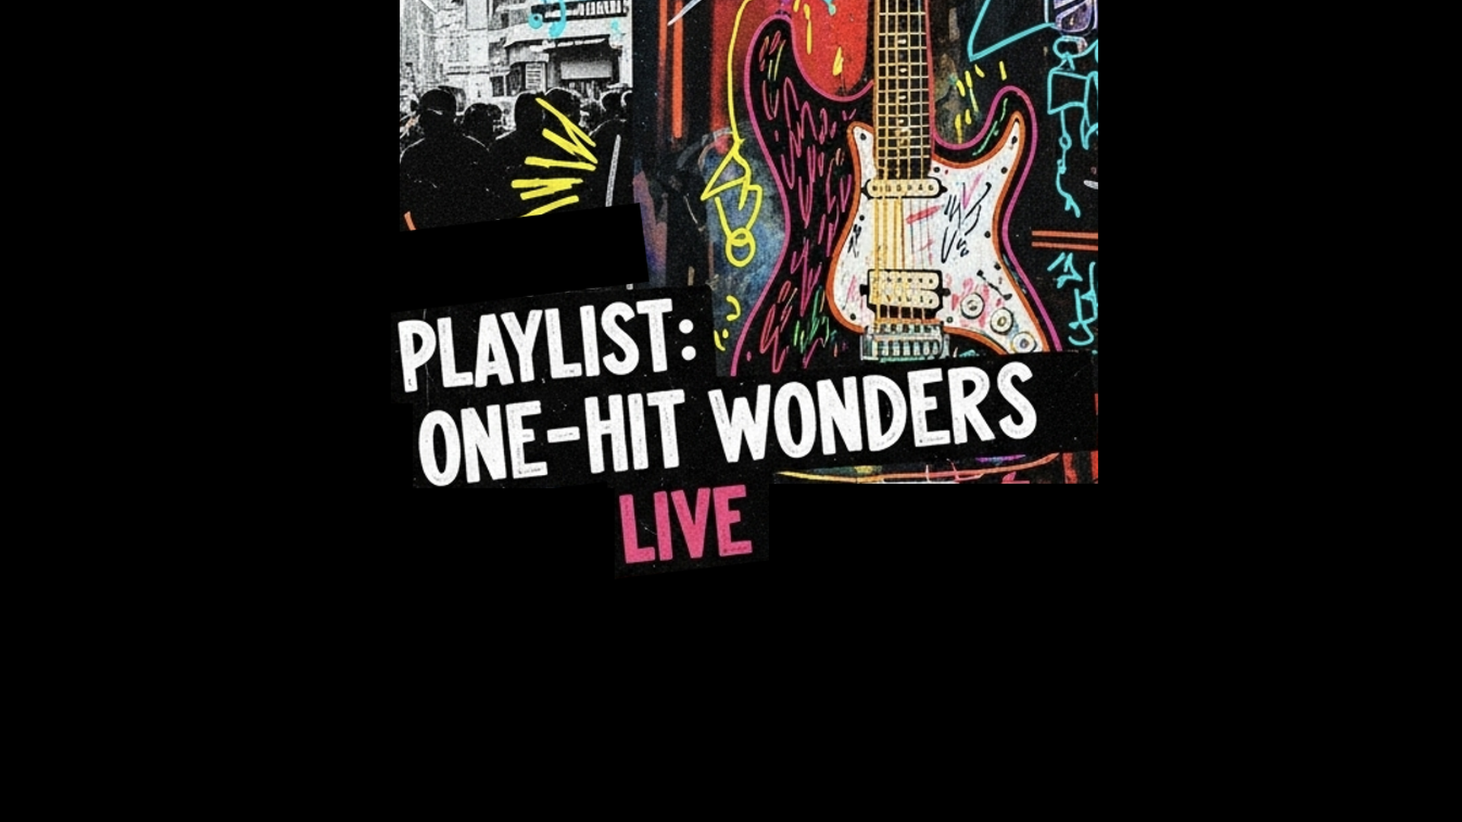
Past Curfew
and Friends
Present:
A
benefit
concert for
October 24, 2025
Tickets at guildtheatre.com
The Guild Theatre | Menlo Park, CA

Slide 15

Past
Curfew
and Friends
Present:
A
benefit
concert for
October 24, 2025
Tickets at guildtheatre.com
The Guild Theatre | Menlo Park, CA

Slide 16

Past
Curfew
and Friends
Present:
A
benefit
concert for
October 24, 2025
The Guild Theatre | Menlo Park, CA

Slide 17

Past
Curfew
and Friends
Present:
A
benefit
concert for
October 24, 2025
The Guild Theatre | Menlo Park, CA

Slide 20

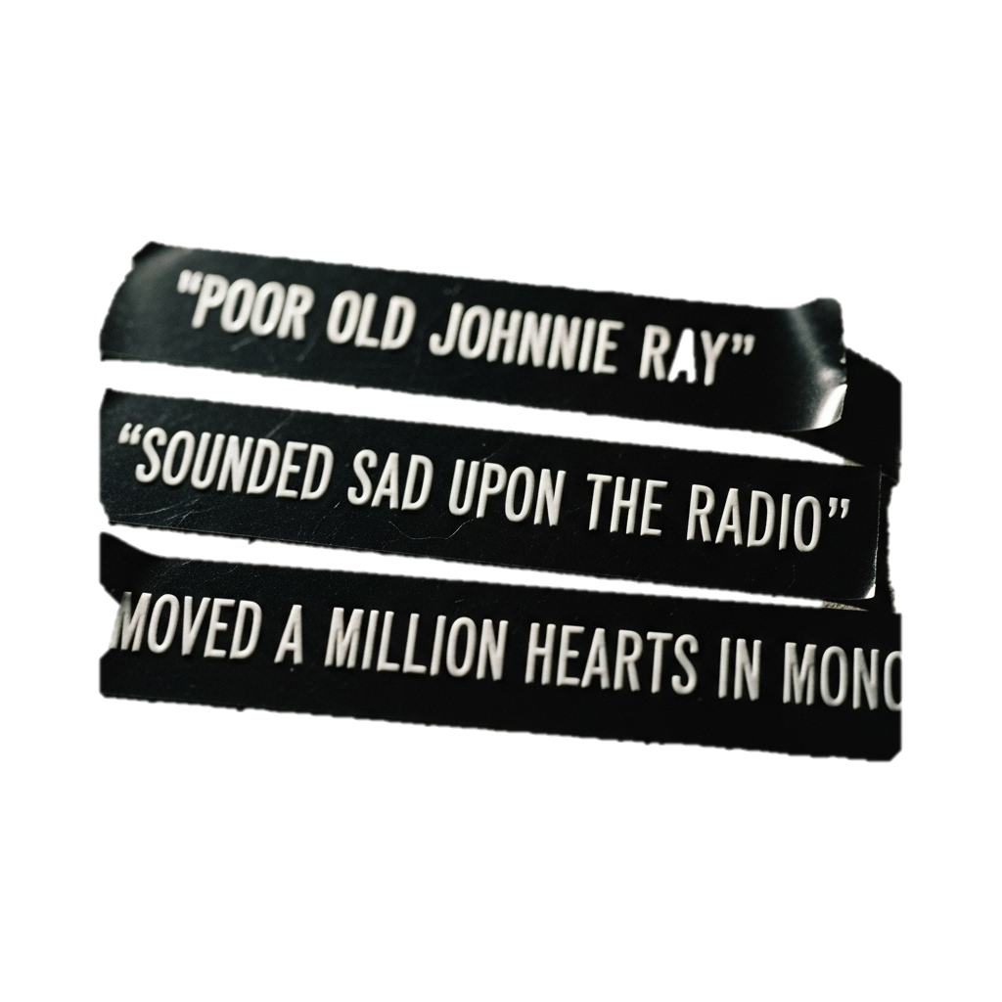

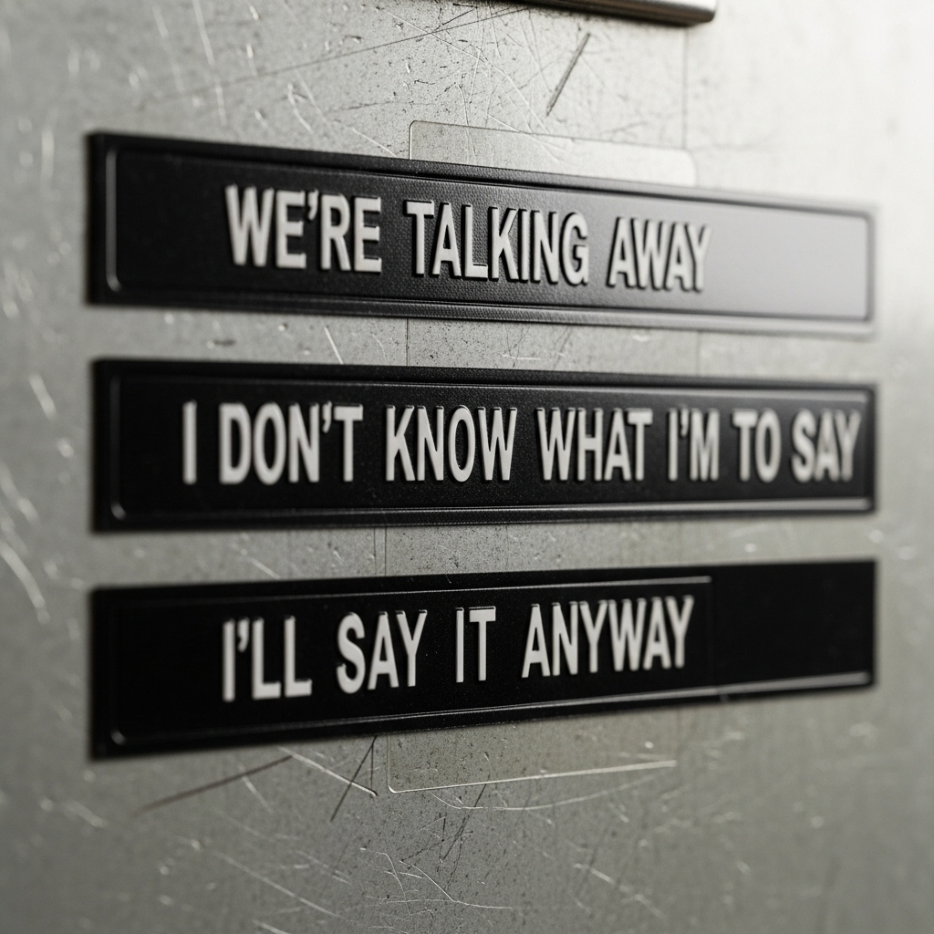
October 24, 2025

Slide 21
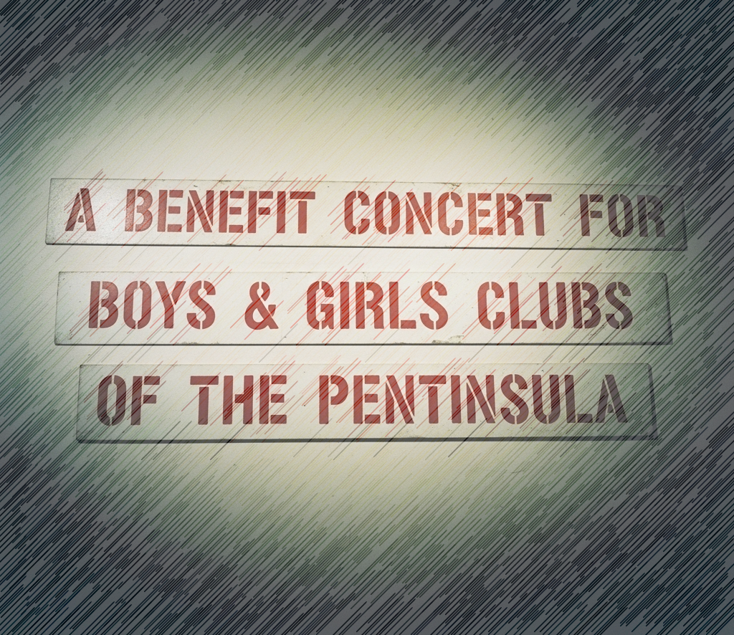
October 24, 2025

Slide 22
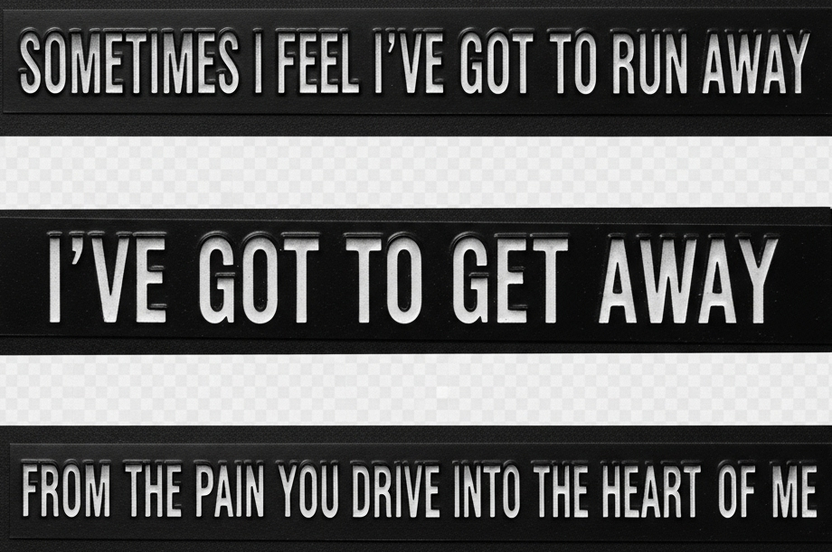

Slide 23
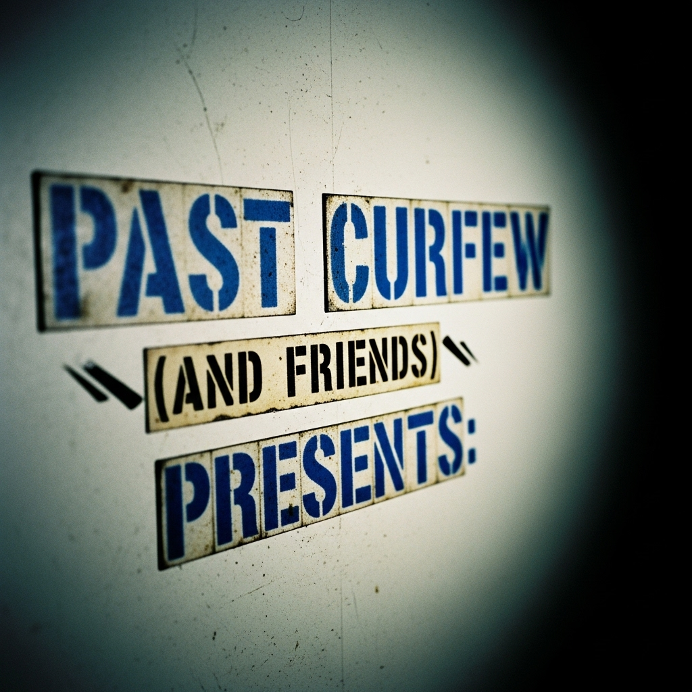
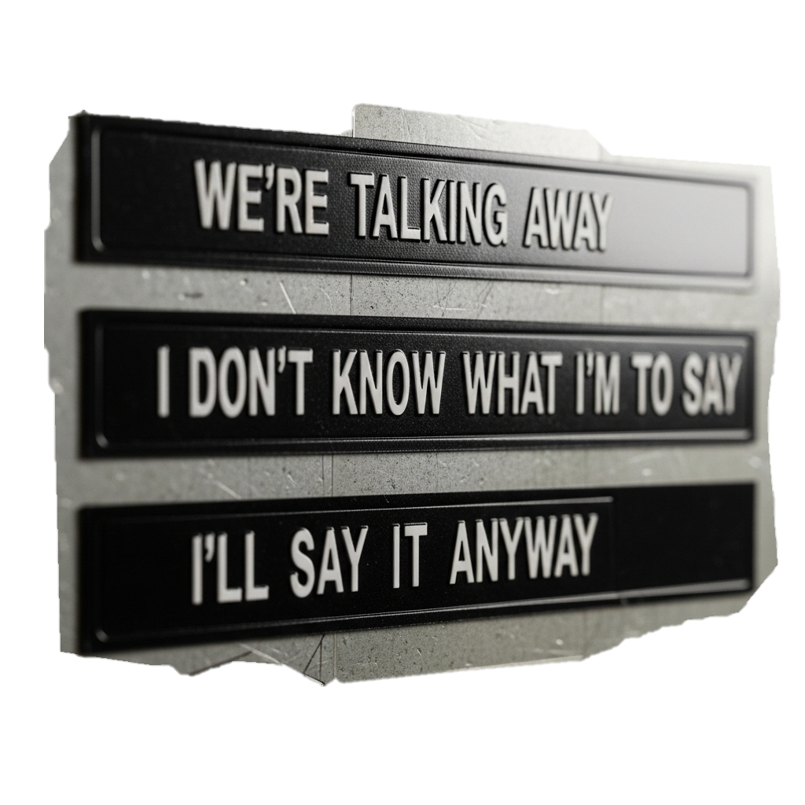

Slide 24
